Slide 1
IoT Ecosystem Using Wireless Technologies Part-2 (Unit-II)
Date: 06.03.2023
5G
Software-Defined Networking - SDN
Ultra-Wide Band Technology - UWB
Near Field Communication Technology - NFC
Low Power Wide Area Networking Technologies
-- Sigfox, (LPWAN)
-- Weightless,
-- LoRa.

Slide 2
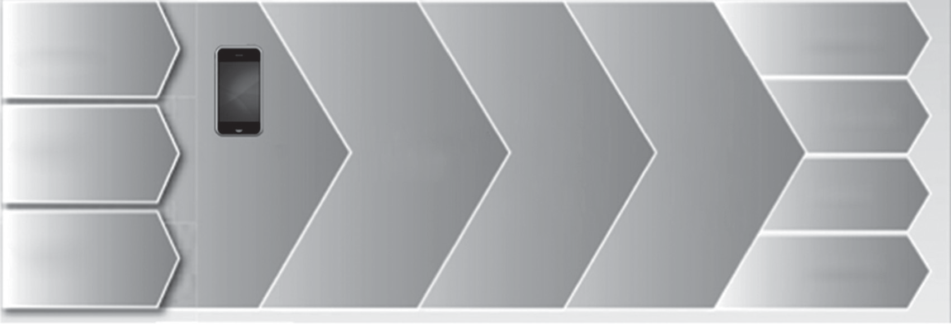
Architecture for IoT using Mobile devices
Mobile data
Transport
Order mgt Price mgt
Service delivery
Applications
websites Smart energy Customer
interface
Data management
M2M data
Connectivity
and analytics
platform
Portals mHealth
messaging
Smart buildings
Financial mgt
C
Infrastructure embedded data
ustomer mgt
Access
Enabling services
Full service delivery

Slide 3
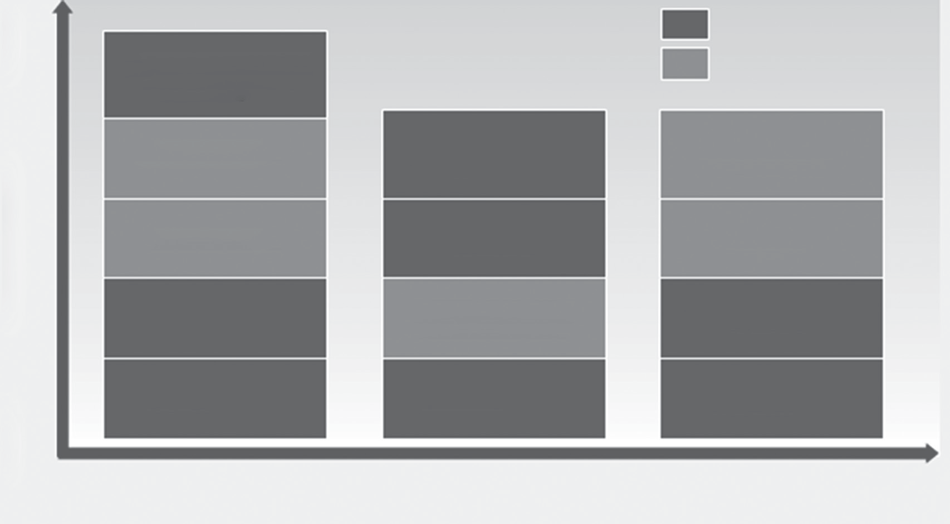
Latency and bandwidth requirements of various types of IoT services
Medium-high latency
Low latency
Home automation gateways
Surveillance
Home education
Mobile robots
Smart grid
Street lamps
Remote health monitoring
Assisted living wristband
eCall
In-car monitoring
Smart meter
Pharma sensors
Logistics
Fixed
Limited Mobility
Fully mobile

Slide 4
Mobile Technologies for supporting
IoT ECHO system

Slide 5
1. 5G Technology
ADVANTAGES OF MOBILE NETWORKS in IoT devices:
Support for massive number of devices (10–100 times more than existing networks)
Support for high data rate (increase the existing data rate 10–100 times)
Reduce the latency between end-to-end devices;
(ideally, the latency< 5 ms)
Provide consistent quality of experience (QoE)
Reduce capital and operations cost

Slide 6
The key features that are used in 5G networks
Software-defined networking (SDN)
Centralized control of multivendor network equipment
Reduced complexity through automation-Dynamic path
Improved network reliability and security
Better user experience
Easily Programmable
Network functions virtualization (NFV)
NFV uses virtualization technologies to provide specific network related services without the necessity to have custom hardware appliances for each network function

Slide 7
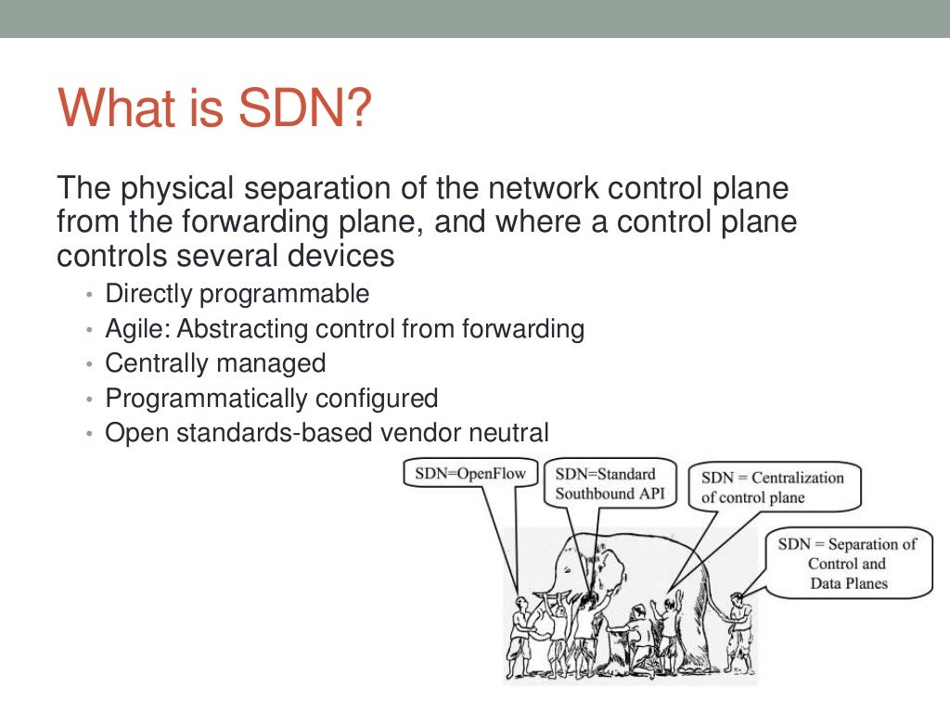

Slide 8
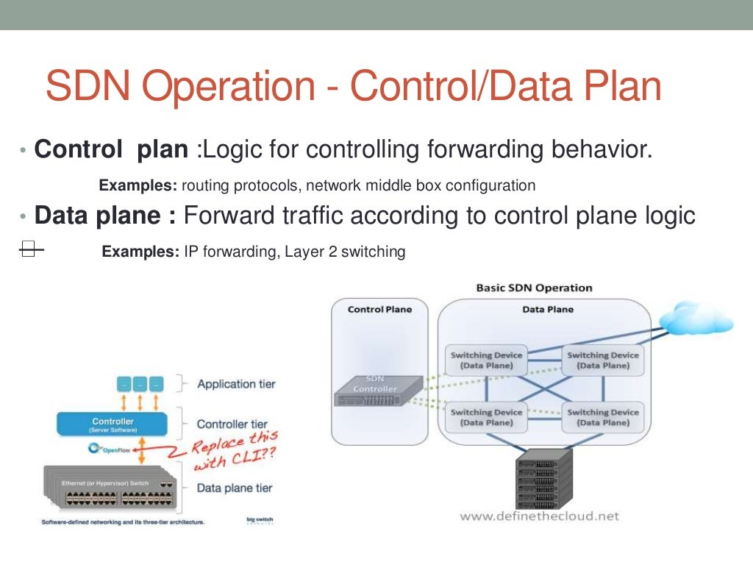

Slide 9
2. Ultra-Wide Band Technology - UWB
is a radio technology
use a very low energy level for short-range, high-bandwidth communications over a large portion of the radio spectrum
used for communication among low-range and low-power sensors
mobile devices that require very low power and high bandwidth.
UWB features makes IoT communication effective:
Resistance to multipath fading
Possibility of high accuracy transmission even indoors
Good scalability in dense deployment
Low-power consumption
High bandwidth transmission Range: 1 to 50 Meters

Slide 10
3. Near Field Communication Technology (NFC)
NFC = RFID (radio frequency identification) + networking technologies (e.g. LAN,WAN,MAN,CAN,WLAN, SAN)
NFC enabled consumer devices can be used to store and exchange any types of personal data like messages, photographs, MP3 files, and so on.
The features of NFC make it very suitable for IoT communication:
Ease of use
Instant natural connectivity
Zero configuration
Smart key access

Slide 11
Applications of NFC
MOBILE E-TICKETING — A REAL LIFE CASE
MOBILE PAYMENT AND E-TICKETING
METRO TRAIN TICKETS
BILL GENERATION IN SHOPPING MALLS
UPI PAYMENTS

Slide 12

Any Doubts

Slide 13
4. Low Power Wide Area Networking (LPWAN)
** LPWAN is an Interconnection of devices and applications
Used for:
are used extensively for communication in the IoT ecosystem.
LPWAN technologies are superior to Bluetooth for M2M communication because of their cost effectiveness and low-power consumption.
LPWAN technology is ideal for connecting devices that send small amounts of data over a long range with battery efficiency.
Eg: sensors, which are used for transmitting data within smart homes, buildings, parking systems, and so on.

Slide 14
LPWAN (Conti…)
Protocols/topologies:
Sigfox -Unlicensed LPWAN
Weightless
LoRa
Nwave
Ingenu
NB-IoT -- Licensed LPWAN
LTE-M

Slide 15
LPWAN(Conti…)
The key features of LPWAN that make it suitable for IoT ecosystem are the following:
Long-range communication
It Supports greater than or equal to 10 km distance from the
gateway.
Low transmission data rate
Less than 5000 bits of data are sent per second.
Often only 20–256 bytes per message sent several times a day.
Low-power consumption
It provides very long battery life for the devices.
The battery life may last up to 10 years.

Slide 16
LPWAN(Conti…)
LPWAN technology is ideally suited for the following two types of applications:
1. Fixed, medium-to-high density connections:
It is used in cities and for buildings as an alternative option for cellular communications.
Eg: Smart grids, GPS-based asset tracking systems, and smart lighting systems.
2. Long life, battery powered applications:
For applications that need a long range.
Eg: Water meters, gas detectors, smart agriculture systems etc.

Slide 17
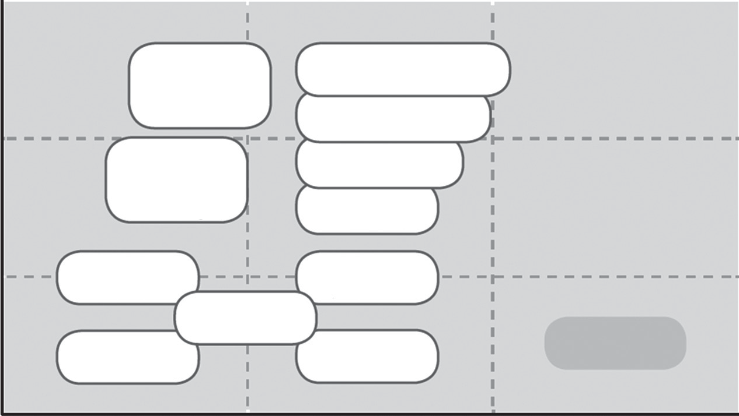
Bandwidth Requirement of LPWAN
B
A
N
D
W
I
D
T
H
Requirement
5G
4G
3G
2G
802.11ac
802.11ad
802.11n
802.11a
802.11b
802.11g
ZigBee 802.15.4
WPAN 802.15.4
Bluetooth-BLE
(Low Energy)
WBAN 802.15.6
LPWAN
RFID/NFC

Slide 18
(LPWAN Conti…)
The most common important parameters to choose a LPWAN technology:
Capacity
Quality of service
Range
Reliability
Battery life
Security
Cost
Proprietary versus standard

Slide 19
(LPWAN Conti…)
LPWAN Network Topologies
LPWAN has two network topologies:
1. Direct device connectivity (base station)
2. Indirect device connectivity through an LPWAN
gateway

Slide 20
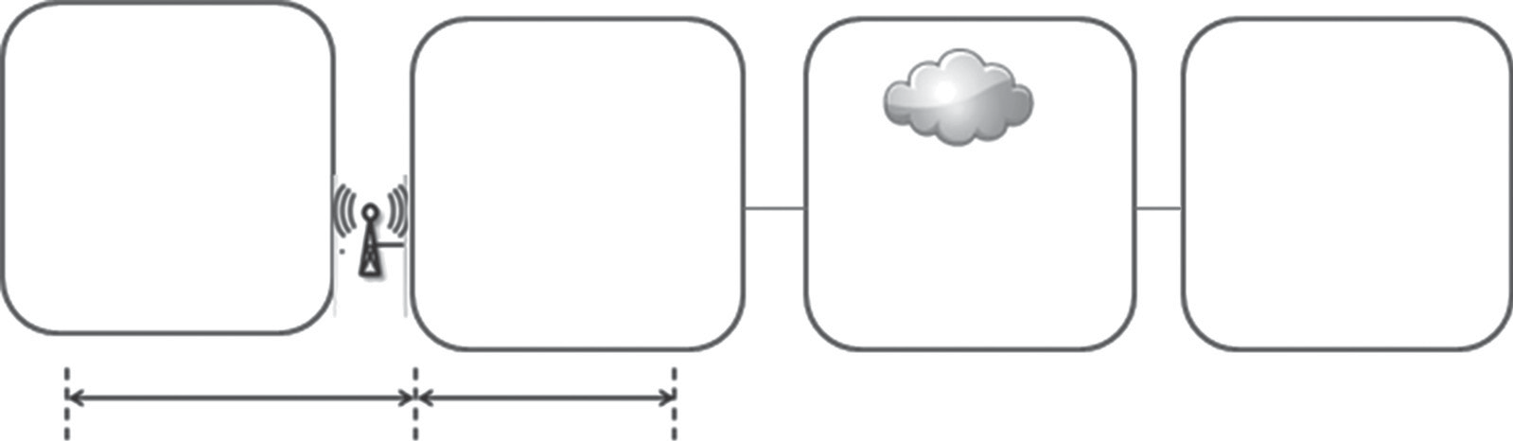
1. Direct Device Connectivity Topology of LPWAN
The base station that is present in the network provides connectivity to many devices.
The traffic is sent to servers (cloud) through TCP or IP-based networks (Internet).
The base station is responsible for translation of protocol from IoT protocols such as MQTT or CoAP to specific device application protocols.
LPWAN Access n/w Cloud and Applications
servers
Wired backhaul, TCP/IP-based (e.g., MQTT)
Star topology for long-range radio connectivity

Slide 21
2. Indirect Device Connectivity through an LPWAN Gateway
where it is not possible to connect devices directly to LPWAN, a local gateway is used for short range radio like ZigBee or BLE.
The gateway runs on mains power as it has to support a large number of devices.
The gateway has a capability to perform protocol conversion from SRD (software defined) radio technologies to LPWAN technology.
Gateways provide more security to IoT ecosystem using powerful security algorithms.
E.g. Sigfox

Slide 22
LPWAN (Conti…)
Protocols/topologies:
Sigfox
Weightless (types N,P,W)
LoRa
Nwave
Ingenu
- Next Sesson

Slide 23
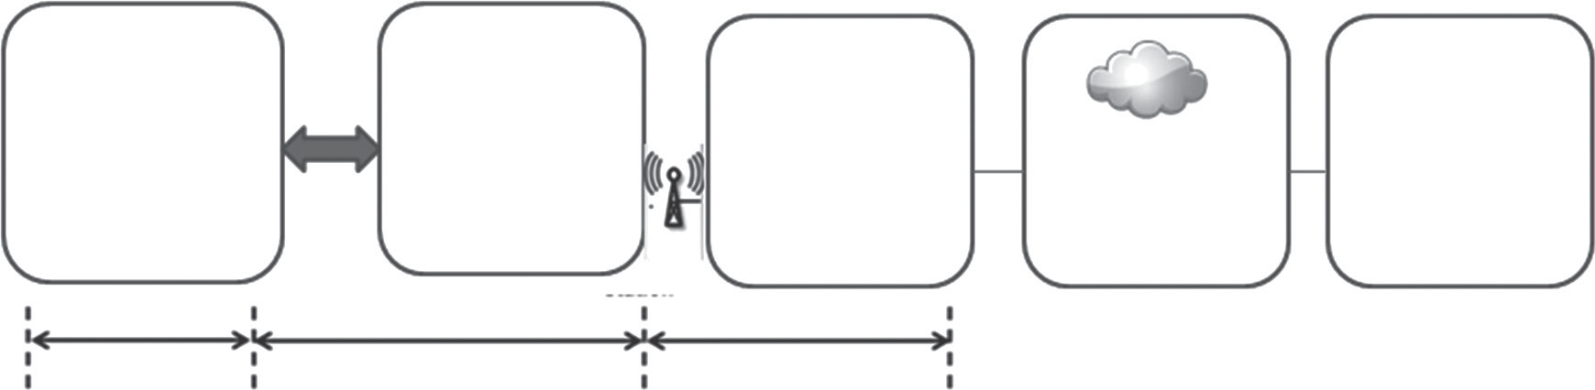
1. Sigfox
Short range
Comm
LPWAN Access n/w Cloud and Applications
servers
Short range
local connectivity
Star topology for long range radio connectivity
Wired backhaul,
TCP/IP
(e.g., MQTT)

Slide 24
Sigfox -- BPSK
Binary Phase Shift Keying
Modulation:
Modulation is the process of converting data into radio waves by adding information to an electronic or optical carrier signal. A carrier signal is one with a steady waveform(Sin, Cos) -- constant height, or amplitude, and frequency.
Phase-shift keying (PSK) is a modulation technique that transmits data by changing the phase of the reference signal, which is called carrier wave. This technique is widely used for data transmission RFIDs, wireless LANs, and Bluetooth.
Binary phase shift keying (BPSK) is the simplest form of PSK. It uses two phases that are separated by an angle of 180°. Since there are two phases, this technique is also called 2-PSK.
Sigfox is widely used for applications that send small, infrequent bursts of data.
Ex. Alarm systems, location monitoring systems, and simple metering systems.

Slide 25
Sigfox
popular in the LPWAN industry.
It has partnership with a lot of vendors in the radio space such as Texas Instruments, Silicon Labs, and Axom.
Sigfox does not support bidirectional networks
It supports for uplink for only sensor applications. Because of this restriction , It can transfer only 15 bytes at a time and 10 messages per day.
It limits the usability of technology only for very simple devices. Ex. Street lighting. Smart lighting and Gas level finding
Sigfox uses antennas that are set up on towers in order to receive data from devices such as parking sensors and water sensors.
Data transmissions range: 868 or 915 MHz frequency bands.

Slide 26
2. Weightless
Weightless is an open LPWAN standard. It operates in sub-1GHz unlicensed spectrum. Weightless has three open standards:
Weightless-P
Weightless-N
Weightless-W
2.1 Weightless-P
This standard offers bidirectional communication.
It uses a narrow band modulation scheme in order to provide bidirectional communications capability.
Provides very high quality of service (QoS) parameter that are best in IoT sector
Weightless-P will offer:
The committed performance rate
Network reliability, and
Security parameters
Low Cost when compared to LPWAN
IT consume less than 100 uW power consumption in an idle state. Its very
low if we compare to 3mW which is used by a cellular technologies.

Slide 27
2.2 Weightless-N
It offers one-way communication.
They have a long battery life of about 10 years and have a low network cost.
The Weightless-N standard uses star network architecture.
It works in sub-GHz spectrum using ultra narrow band (UNB) technology.
It offers:
a range of several kilometers even in urban environments.
very low power consumption, which in turn provides a long battery life for devices.
It requires small conventional cells, minimal hardware, and incurs less network costs
It uses Differential binary phase shift keying (DBPSK) digital modulation scheme to transmit using narrow frequency bands.
It uses a frequency hopping algorithm in order to reduce interference.
It supports encryption and implicit authentication using a shared secret key regime in order to encode transmitted information via a 128-bit AES algorithm.
It provide the guaranteed data transmission during mobility as well

Slide 28
2.3 Weightless-W
This standard is the most extensively used option as it runs in the unused TV spectrum.
Data rates from 1 Kbit/s to 10 Mbit/s are possible based on the link budget with the size of data packets starting from 10 bytes.
There is no upper bound on packet size., Interrupt feature supported.
The overhead is extremely low, for example, 50-byte packets have less than 20% overhead.
message transmission modes are supported.
ex: 0ne tp many

Slide 29
2.3 Weightless-W
Service provision layering features provide worldwide contracts and automated change of net work provider capabilities.
Terminals can run multiple applications at the same time, and the mobility is fully supported.
This standard provides an ultra secure 128-bit encryption and authentication model, which is based on a shared secret key. This standard has an extremely low complexity architecture. This straight away svaes battery life.
The frequency hopping and intelligent frequency planning features help to maximize throughput on congested networks.
This standard offers wide range of modulation schemes and
spreading factors. The range is about 5 km in indoor terminals.

Slide 30
2.3 Weightless-W
Service provision layering features provide worldwide contracts and automated change of net work provider capabilities.
Terminals can run multiple applications at the same time, and the mobility is fully supported.
This standard provides an ultra secure 128-bit encryption and authentication model, which is based on a shared secret key. This standard has an extremely low complexity architecture. This straight away svaes battery life.
The frequency hopping and intelligent frequency planning features help to maximize throughput on congested networks.
This standard offers wide range of modulation schemes and
spreading factors. The range is about 5 km in indoor terminals.

Slide 31
3. LoRa (Long Range Radio)
LoRa Alliance12 promotes use of an open standard for LoRa-based networks called LoRaWAN.
LoRa stands for Long Range Radio and is mainly targeted for M2M and IoT networks.
This standard was developed by Semtech, IBM research, and Actility.
Few main features of LoRaWAN:
They have three open standards that provide various types of options for end users.
Since it is an open ecosystem, there are a lot of software and vendors that are available in the market for supporting this standard.
This standard lacks many features like support for roaming, packetization, firmware upgrades over air, and so on.
In order to use this standard, the network server software should be run in the cloud which mandates a subscription from a network server vendor
Semtech is the only vendor that manufactures the chips that may impact the scale of production and adoption of this standard.

Slide 32

Any Doubts

